Slide 1



Introduction to Linear Regression
Hafaliana Christian Ranaivoson
Ecology and Evolution (E&E), University of Chicago
Mention Zoologie et Biodiversité Animale (MZBA), University of Antananarivo
Association Ekipa Fanihy (Efa), Madaggascar.
Adapted from Andrés Garchitorena, PhD
(E2M2, 2024)
E²M² Workshop
Andasibe, May 2025

Slide 2
1
Objectives of the lecture
1
1
Remind some basic principles of linear regression
Introduction to generalized linear models
Provide an overview of the steps involved in developing a generalized linear mixed model (tuorial)
« Understand alternatives to the use of mathematical models for the study of dynamical systems »

Slide 3
Being able to use a tool properly
‘ We are introducing to what is “available” (E2M2),
it is up to you to deepen what you think is “worth it” (C4C)’
Some basics first…

Slide 4
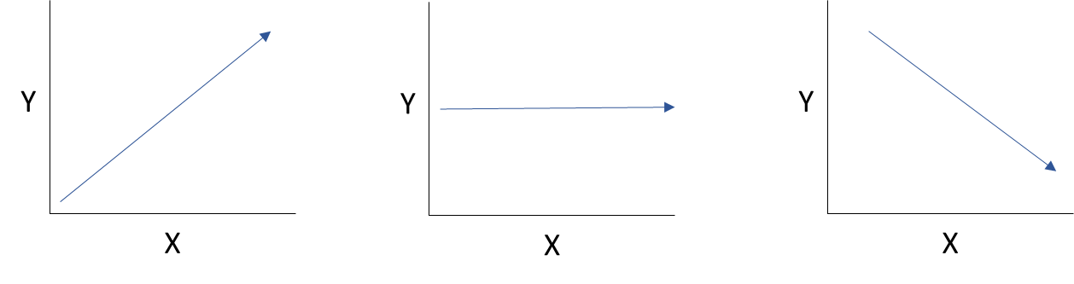
Linear Models
Think about a straight line to describe a trend
Some basics first…

Slide 5
Linear Models
Think about a straight line to describe a trend
Y = f(x)
Some basics first…

Slide 6
Linear Models
Think about a straight line to describe a trend
Y = f(x)
Explanatory variable
Independent variable
(Variable explicative, axe des abscisses)
Some basics first…

Slide 7
Linear Models
Think about a straight line to describe a trend
Y = f(x)
Response variable
Dependent variable
(Variable à expliquer, axe des ordonnées)
Explanatory variable
Independent variable
(Variable explicative, axe des abscisses)
Some basics first…

Slide 8
Linear Models
Think about a straight line to describe a trend
Going up (Miakatra)
Steady (Tsy miova)
Going down (Mihidina)
Some basics first…

Slide 9
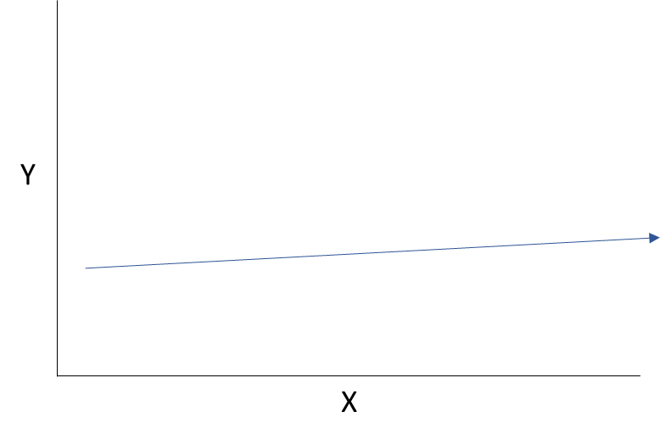
Linear Models
What about this one? (Dia ahoana izany ity?)
Y = f(x)
Some basics first…

Slide 10
1. Univariate
Linear Models
lm()
Considering the effect of only one explanatory variable (x) on a response variable (y) with a normal distribution
(Etudier « l’effet » une seule variable explicative sur une variable réponse ayant une distribution normale)
(Azo tsotsorina hoe fiakinan’ny “y” amin’ny “x” iray ihany)
Some basics first…

Slide 11
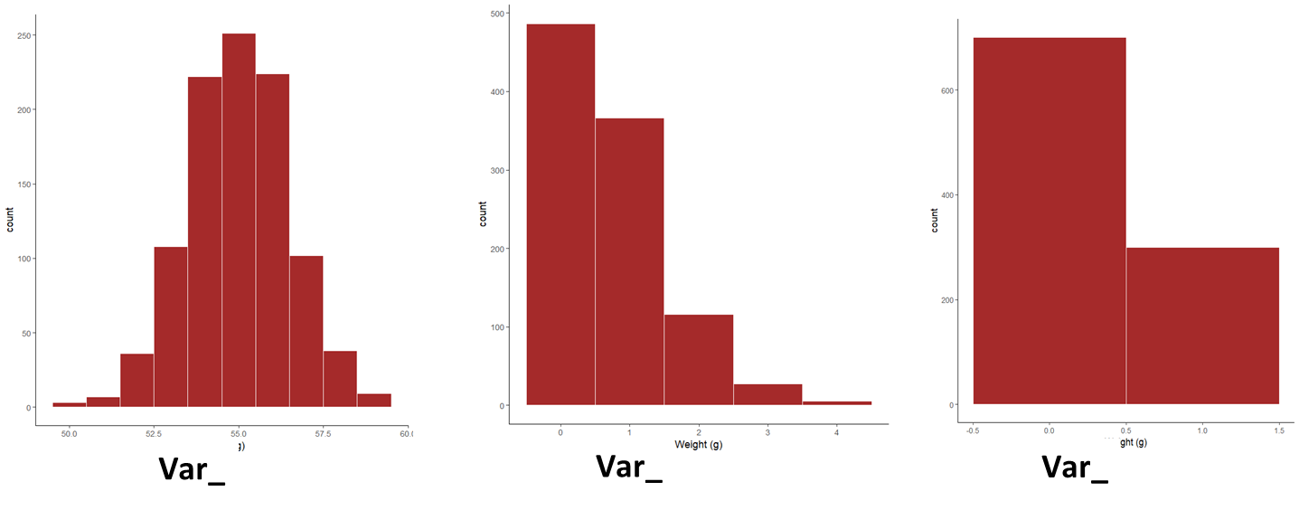
1
1
1
Variables and distributions

Slide 12
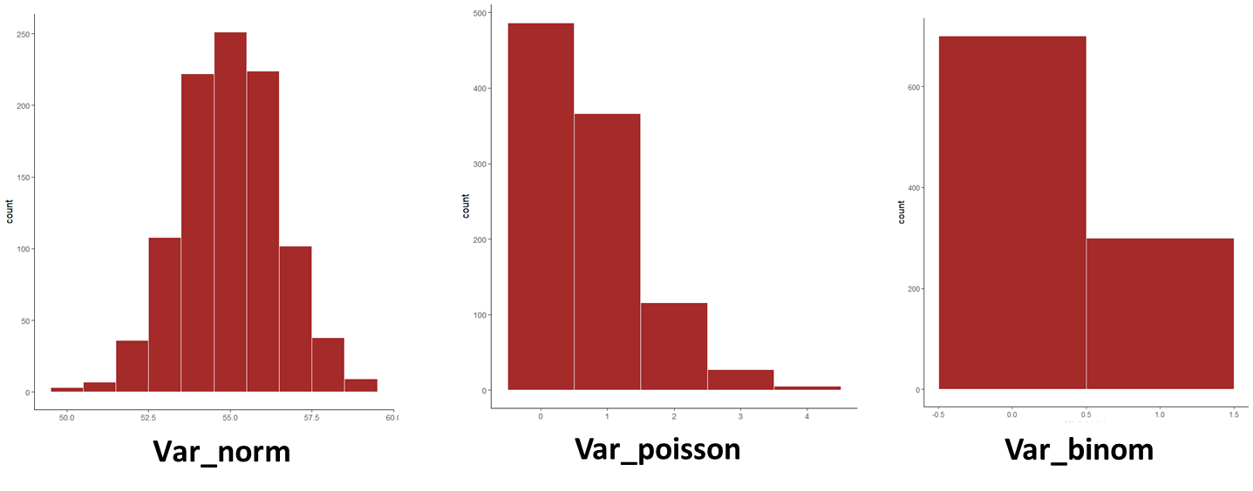
1
1
1
Variables and distributions

Slide 13
1
1
1
Variables and distributions
Continuous
Integer (Count)
Presence/Absence

Slide 14
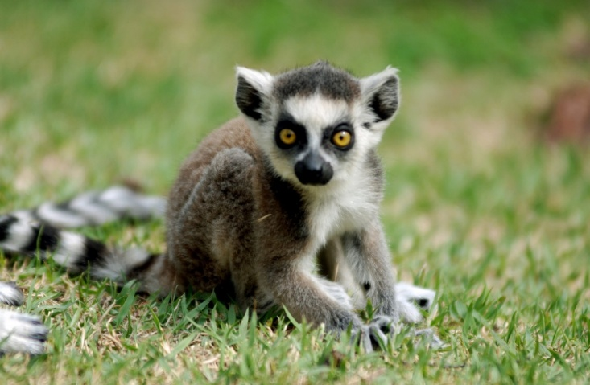
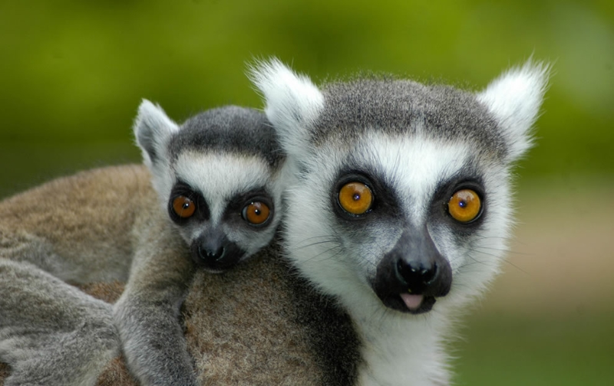
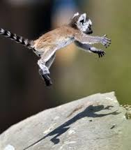
1
1
1
Let’s work through a cute example
Lemurs weight (poids) determinants

Slide 15
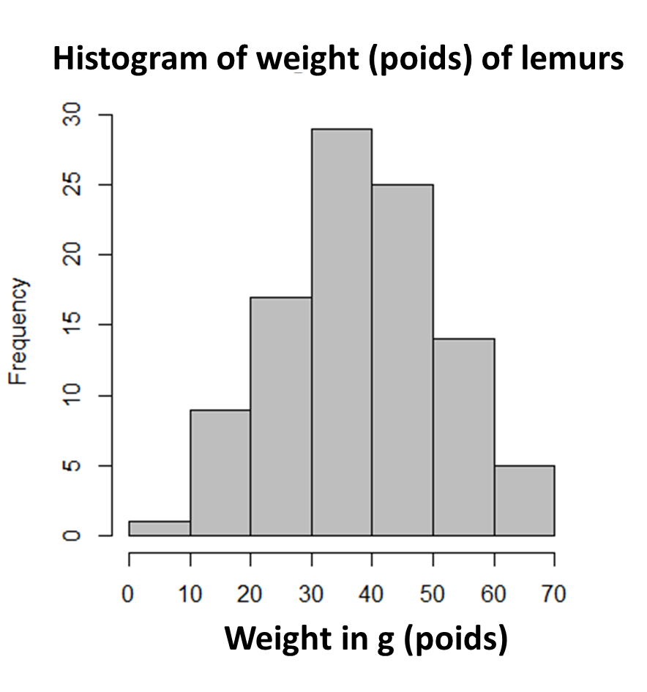

1
1
1
Lemur weight and determinants
$$Zi=\frac{Xi − \overline{X} }{σ}$$
Z ̴N(0, 1)

Slide 16
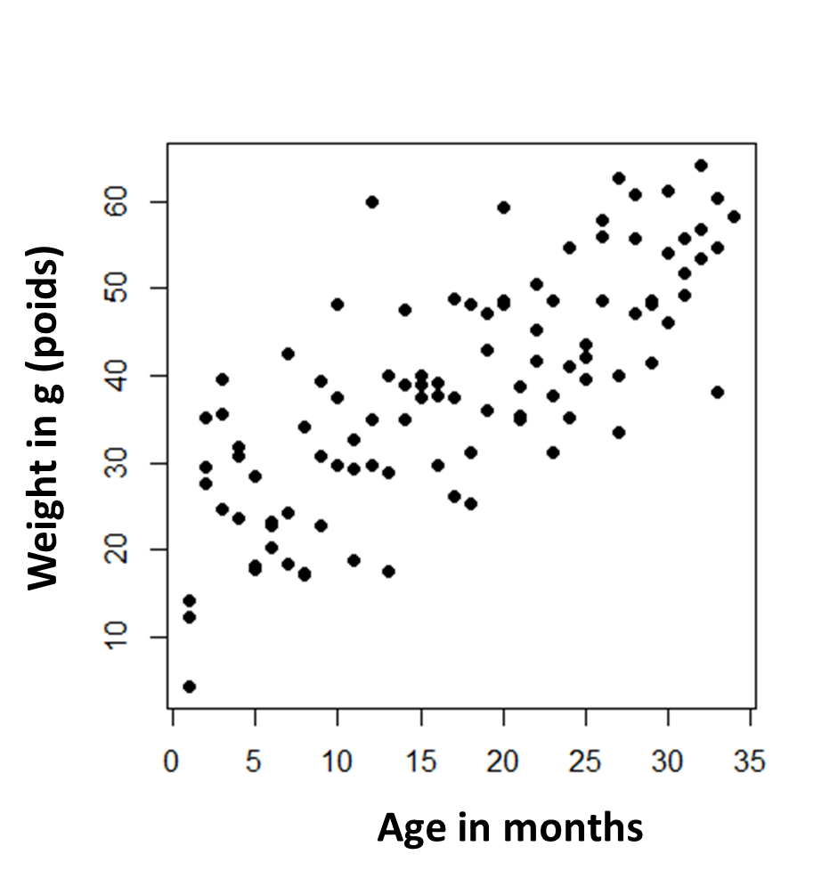
1
1
1
Lemur weight and determinants

Slide 17
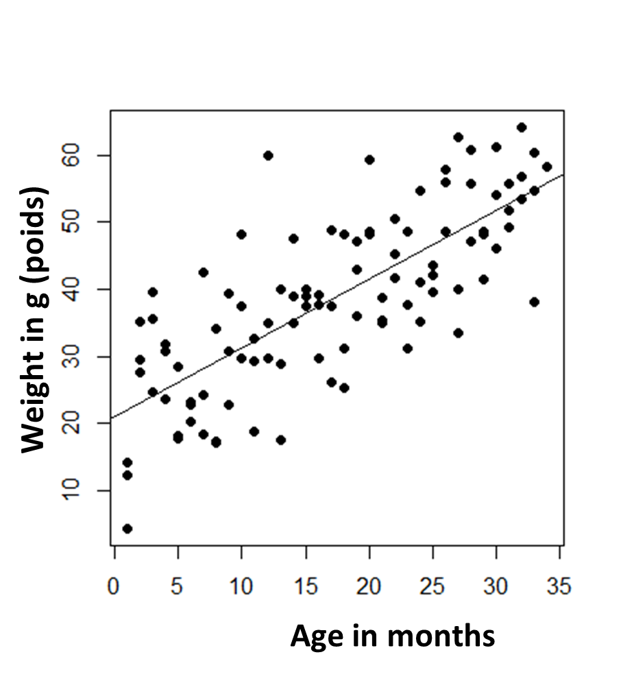
1
1
1
Lemur weight and determinants
lm(formula, data)

Slide 18
1
1
1
Lemur weight and determinants
lm(formula, data)
Formula : Y = f(x)

Slide 19
1
1
1
Lemur weight and determinants
lm(weight ̴ Age, data)
“lm(formula, data)”

Slide 20
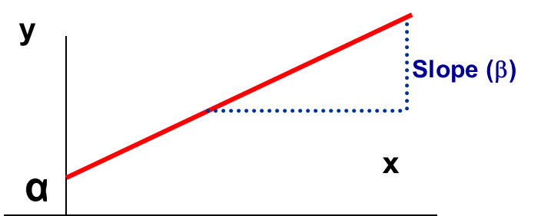
1
1
1
Simple linear regression
Relation between 2 continuous variables
Intercept (α)
Value of y when x is 0
Regression coefficient β₁
Measures association between y and x
Amount by which y changes on average when x changes by one unit
Error (ε)
Difference between the predicted values and observed values of y
Notes:
20
Measure the slope
Beta 1 is the slope
Alpha is the intercept, is the baseline
Beta is the magnitude by which y changes when x changes by one unit
Least square method: sum of all squared deviations. If the sum of all deviations is low, the line is explaining well the association between age and SBP.
Explain least square method on whiteboard

Slide 21
1
1
1
Simple linear regression
f(x) = α + βx + ε
Systematic
component
Residual
component
Response variable =
+
Intercept and explanatory variables
- Null mean
- Independence
- Fixed variance
- Normality
y = α + βx + ε
The R function to fit a linear model is lm() which uses the form
fitted.model <- lm(formula, data=data.frame)

Slide 22
1
1
1
Simple linear regression
f(x) = α + βx + ε
Systematic
component
Residual
component
Response variable =
+
Intercept and explanatory variables
- Null mean
- Independence
- Fixed variance
- Normality
y = α + βx + ε
weight = α + β.age + ε
The R function to fit a linear model is lm() which uses the form
fitted.model <- lm(formula, data=data.frame)

Slide 23

1
1
1
Lemur weight and determinants
lm(weight ̴ Age, data)
Formula : Y = f(x)
y = α + βx + ε

Slide 24
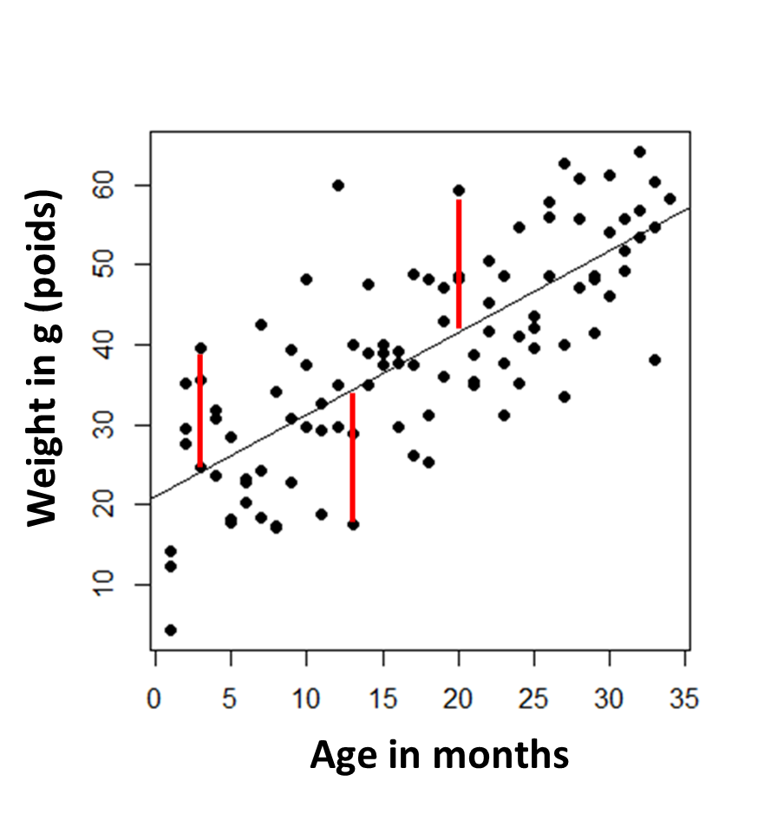
1
1
1
Lemur weight and determinants
y = α + βx + ε

Slide 25
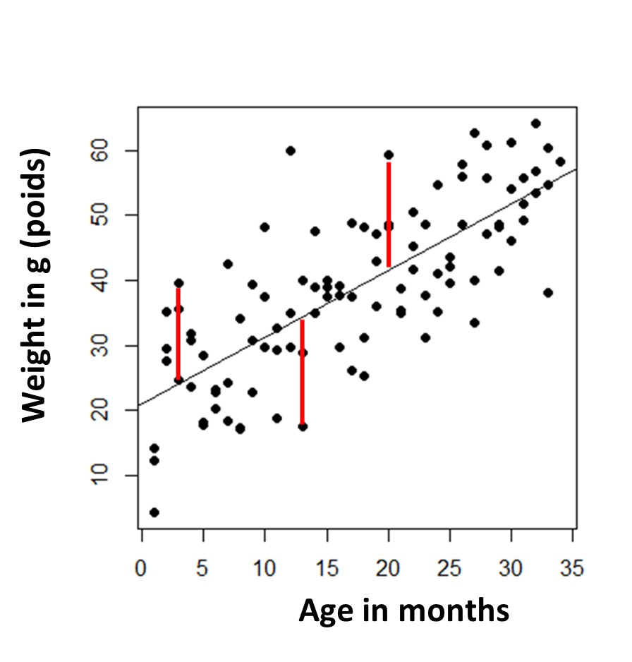
1
1
1
Lemur weight and determinants
The goal is to minimize the difference between what we predict and what we observe
(Méthode des moindres carrés ry reto an!)
y = α + βx + ε

Slide 26
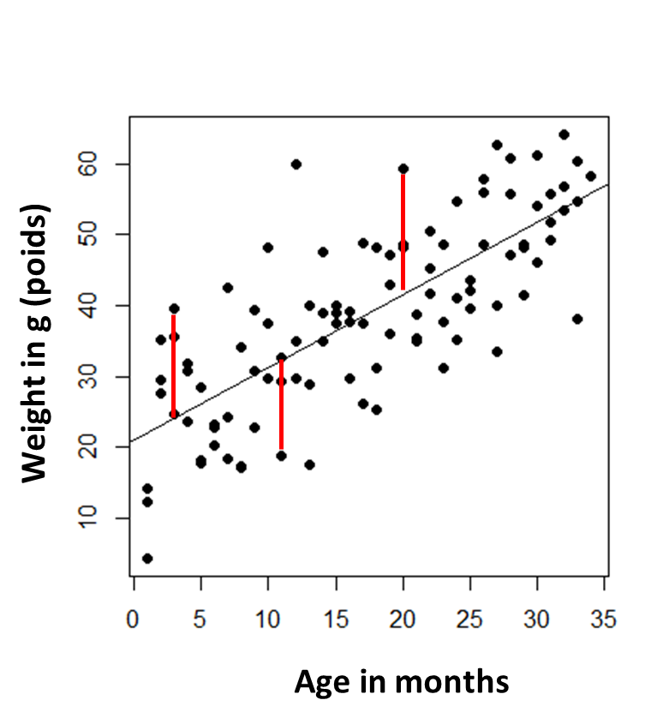
1
1
1
Simple linear regression
weight = 20 + 1.15 x Age (months) + Error

Slide 27
A process is generally the result of several others…
Mety hoe tsy ny mahabe ny taona ihany no mampavesatra ny lanja an!

Slide 28
1. Univariate
Linear Models
lm()
2. Multivariate
Linear Models
lm()
Considering the effect of multiple explanatory variables (x₁, x₂…x_{n}) on a response variable (y) with a normal distribution
(Etudier « l’effet » de plusieurs variables explicatives sur une variable réponse ayant une distribution normale)
(Azo tsotsorina hoe fiakinan’ny “y” amin’ny “x” maromaro)
Introducing multivariate
linear models

Slide 29
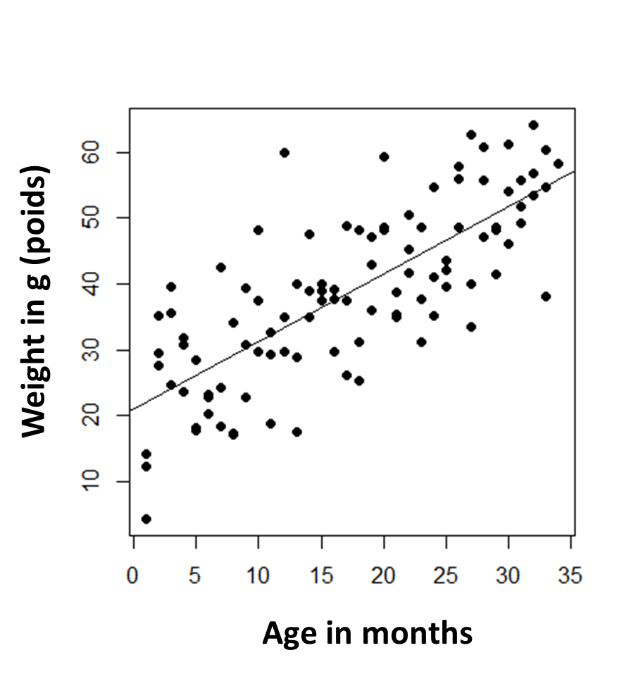
1
1
1
Lemur weight and determinants

Slide 30
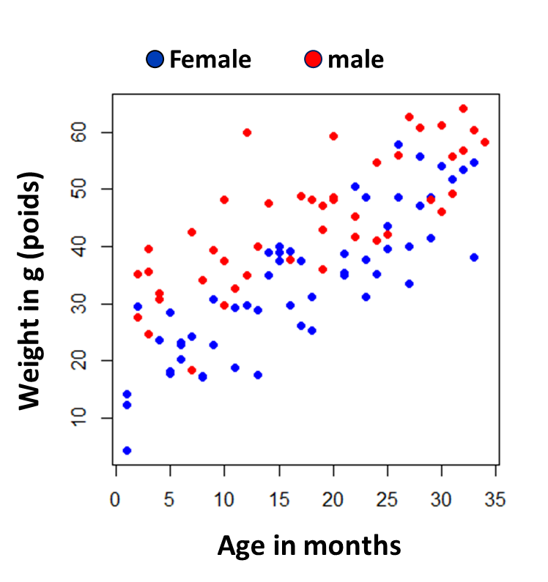
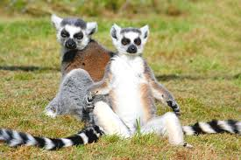
1
1
1
Lemur weight and determinants
The effect of gender

Slide 31
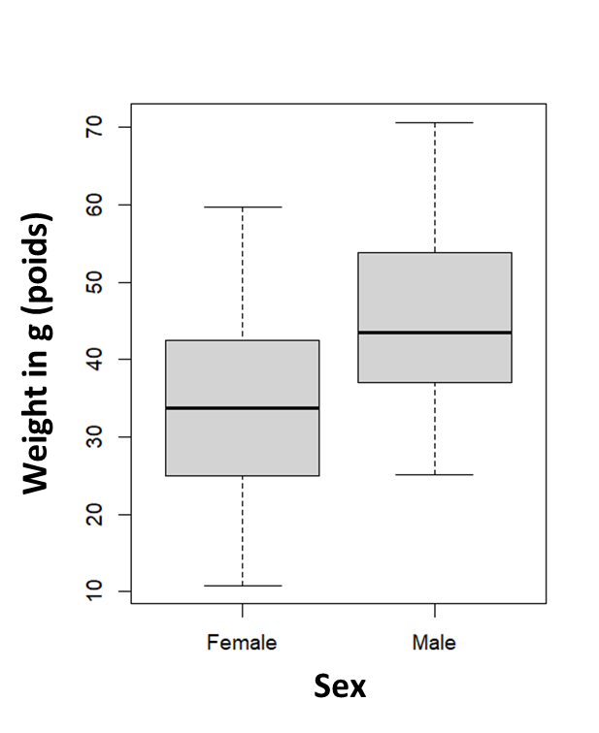
1
1
1
Lemur weight and determinants
The effect of gender
Taille = 15 + 1.15 x Age (months) + 15 x Sexe (male) + Error

Slide 32
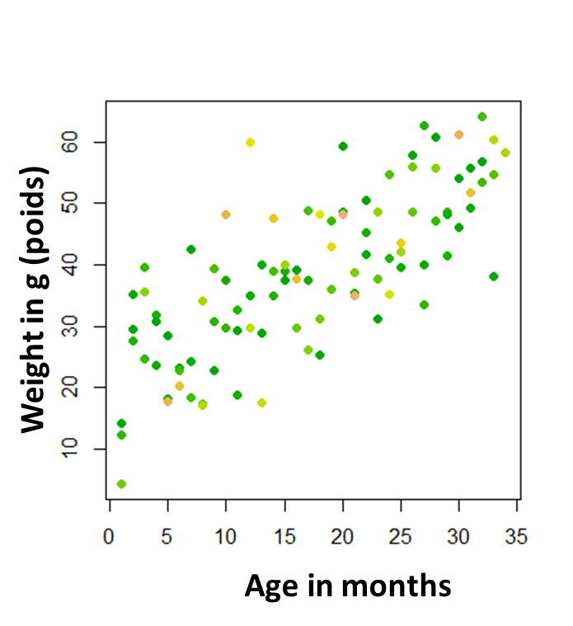
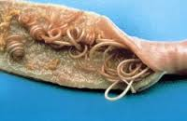
1
1
1
Lemur weight and determinants
The effect of parasites
Green: low parasite burden
Yellow: high parasite burden

Slide 33
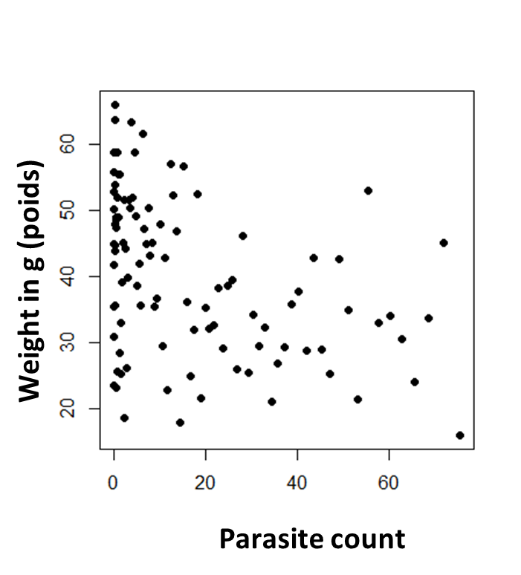
1
1
1
Lemur weight and determinants
The effect of parasites

Slide 34
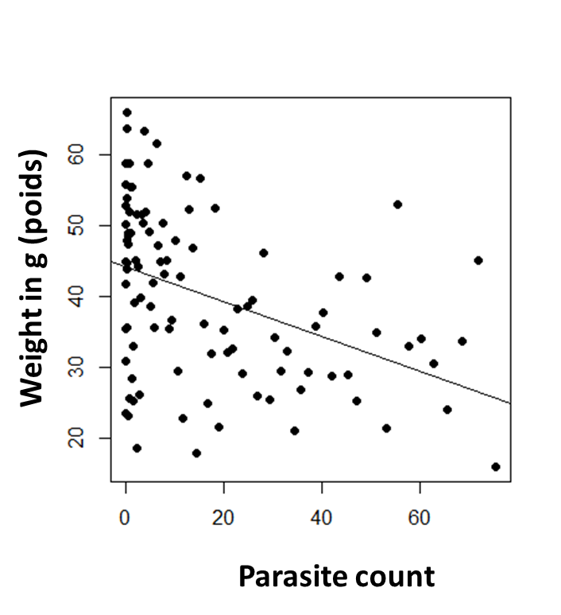
1
1
1
Lemur weight and determinants
The effect of parasites
Taille = 45 - 0.3 x Nb Parasites + Error

Slide 35
1
Lemur weight and determinants
lm(taille ̴age+sexe+GIparasites, data)

Slide 36
1
1
1
Multiple linear regression
Linear regression with multiple explanatory variables
To describe the relationship between
The response variable, y
The explanatory variables, x = (x₁,x₂,…,x_{n})
The model: y = α+ β₁*x₁ +…+ β_{n}*x_{n}+ ε
with ε ~N(0,σ²)
We generally select the model that best fits the data (best explains observed patterns) with the smallest number of variables

Slide 37
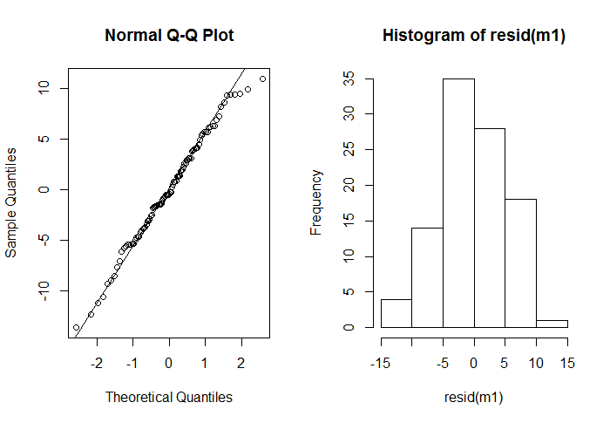
3
Model validation (case of linear regression y ̴N(0,1))
Check that model assumptions have not been violated
Normality of residuals

Slide 38
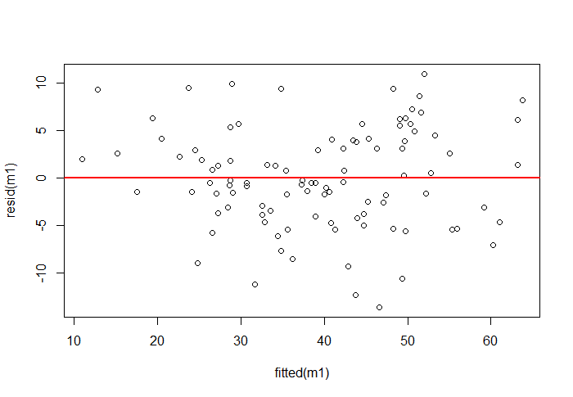
3
Model validation (case of linear regression y ̴N(0,1))
Check that model assumptions have not been violated
Homogeneity of residuals

Slide 39
Unfortunately, not all things in life are normal…

Slide 40
1. Univariate
Linear Models
lm()
2. Multivariate
Linear Models
lm()
3. Generalized
Linear Models
glm()
Case when the response variable do not follow a Normal distribution
(Dans le cas ou la variable réponse ne suit pas une distribution normale)
Dia ahoana raha tsy manaraka ny “distribution normale” ny “variable response”?
Introducing generalized
linear models

Slide 41
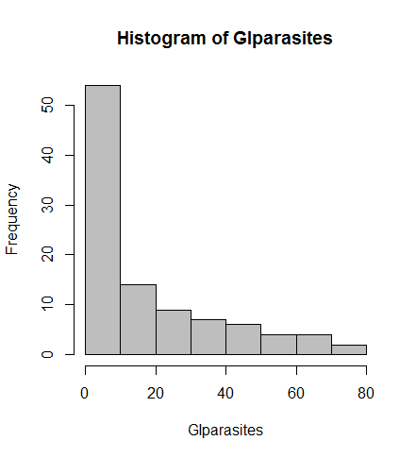
Count data
Cannot be negative
Discrete values
The lower the values, the « less normal » they generally are.
Examples:
Number of individuals of a species X
Number of people with a disease X

Slide 42
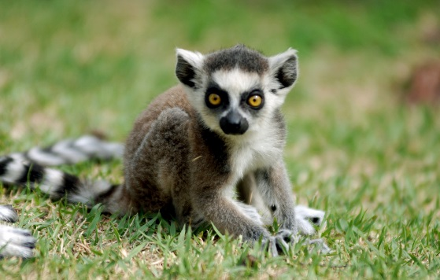
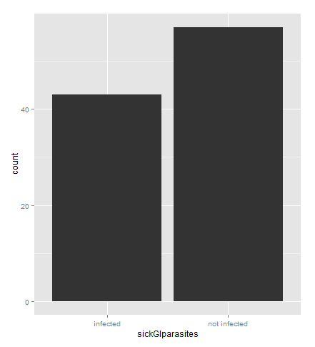
Binary data (events)
Values either 1 or 0 (either happened or not happened)
The outcome variable is the number of successes /failures
Examples:
Presence of a species X
Presence of a disease X

Slide 43
Limitations of linear models
In this type of situations, general linear models are not appropriate because:
The range of Y is restricted (e.g. binary, count)
The variance of Y depends on the mean
Generalized linear models extend the linear model framework to address both of these issues by using a linear predictor and a link function

Slide 44


Generalized linear modeling
One generalization of multiple linear regression. Response, y, predictor variables x₁, x₂, …. The distribution of Y depends on the X’s through a single linear function, the “linear predictor”
A link function describes how the mean E(Y) = μ, depends on the linear predictor v.

Slide 45
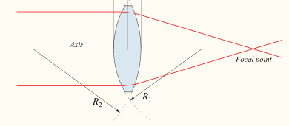
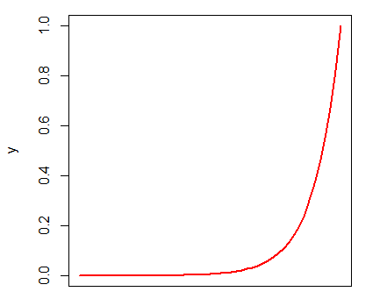
Generalized linear modeling
Most common families and links
Gaussian: identity
Poisson: log
Binomial: logit
Negative binomial: log
Y= e ^{(α + β x)}
V = α + β x
v
(log)
β
x
x

Slide 46
Generalized linear modeling
Most common families and links
Gaussian: identity
Poisson: log
Binomial: logit
Negative binomial: log
(logit)
V = α + β x
v
β
y
x
x

Slide 47
Generalized linear modeling
Most common families and links
Gaussian: identity
Poisson: log
Binomial: logit
Negative binomial: log
The R function to fit a general linear model is glm() which uses the form
fitted.model <- glm(formula, family=“model family”, data=data.frame)

Slide 48

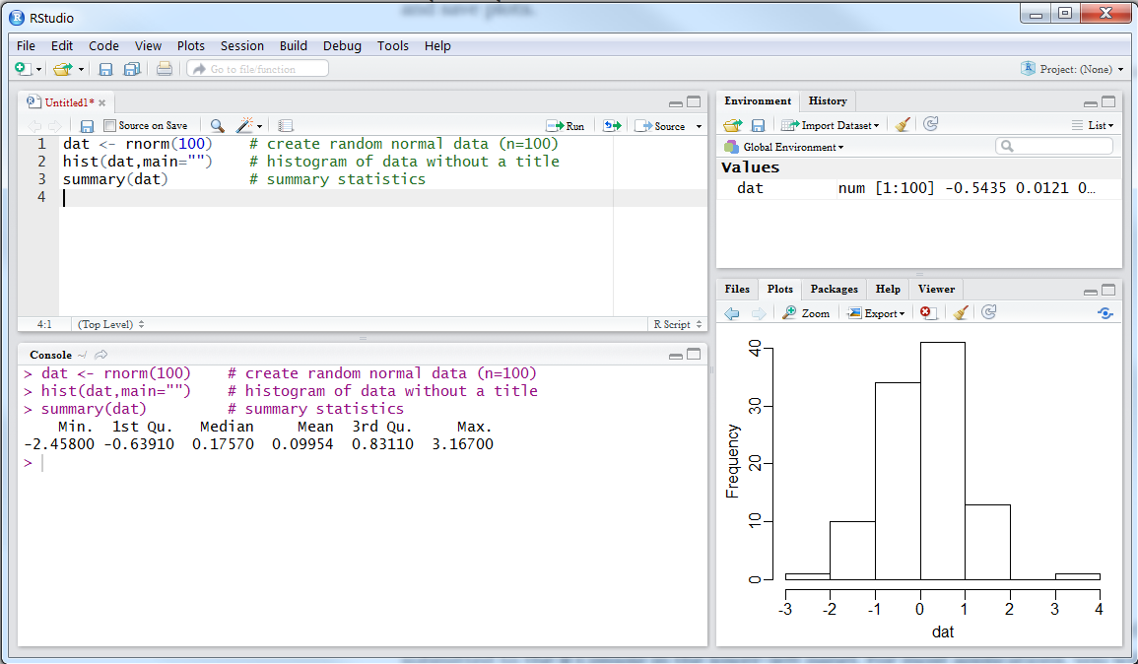
1. Univariate
Linear Models
2. Multivariate
Linear Models
3. Generalized
Linear Models
Steps in development of
statistical models (tutorial)

Slide 49
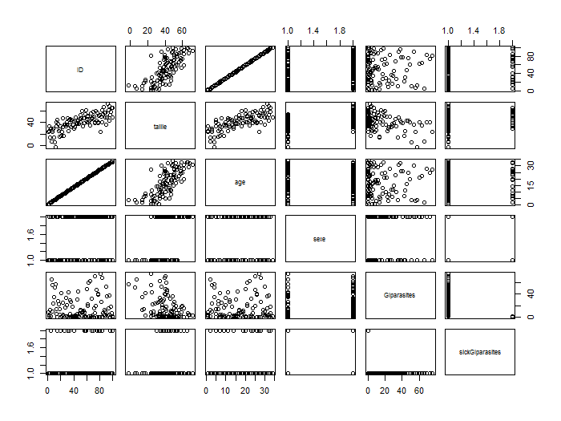
3
Database construction and descriptive analyses
pairs(mydata)
Relationships between the variables

Slide 50
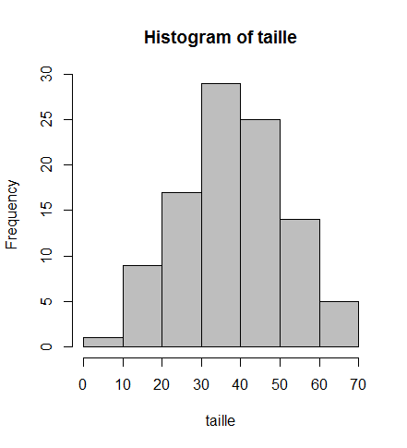
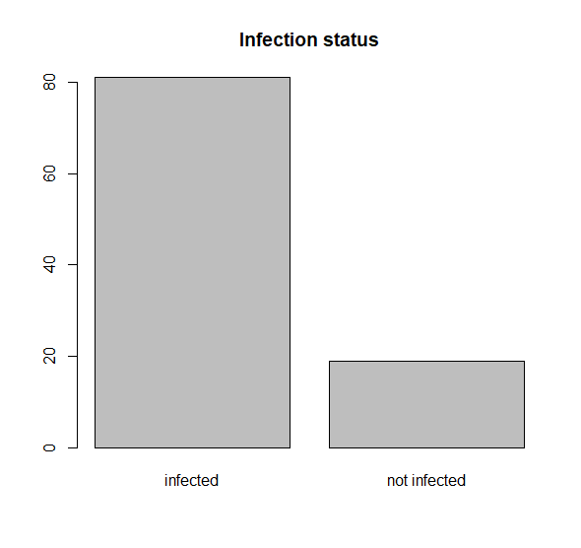
3
Database construction and descriptive analyses
Distribution of the response variable
Distribution of the explanatory variables
hist(mydata$var)
hist(mydata$var)
plot(mydata$var)

Slide 51
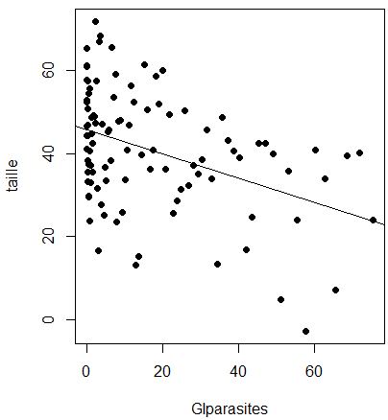
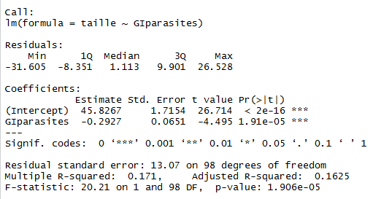
3
Univariate analyses
Quantify the stregth of the relationship between the response variable and each explanatory variable
Test the significance of the relationship between the response variable and each explanatory variable
Model1 = lm(taille~GIparasites, data=mydata)
summary (Model1)

Slide 52
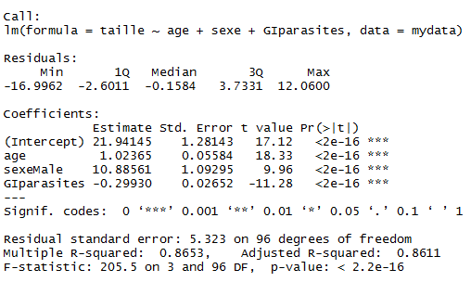
3
Multivariate analyses
Quantify the relationship between the response variable and a set of explanatory variables
Model1 = lm(taille~age+sexe+GIparasites, data=mydata)
summary (m1)
Select the set of predictors that best explains the response variable (backwards, forward, stepwise)
drop1 (m1)
add1 (m1)
step (m1)

Slide 53
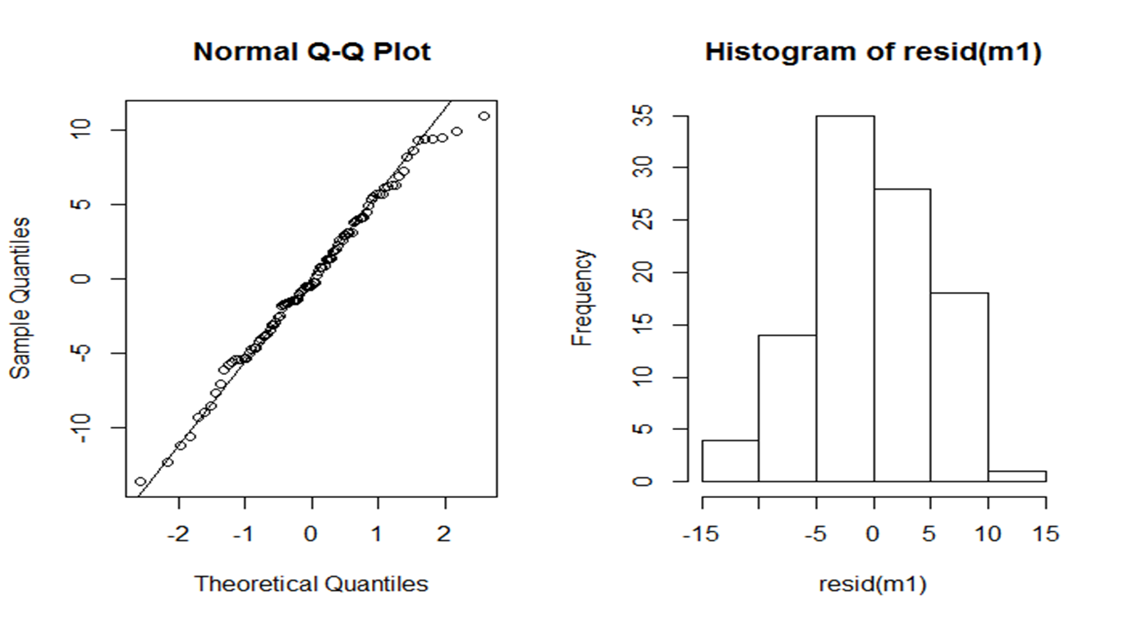
3
Model validation (case of linear regression y ̴N(0,1))
Check that model assumptions have not been violated
Homogeneity of residuals

Slide 54
Assumption and limitation of lm, glm
all observations are considered independent, or they are often nested

Slide 55
1. Univariate
Linear Models
lm
2. Multivariate
Linear Models
lm
3. Generalized
Linear Models
glm
4. Linear Mixed Models , Generalized Linear Mixed Models
lmm, glmm
Introduction to Generalized
Linear Mixed Models

Slide 56

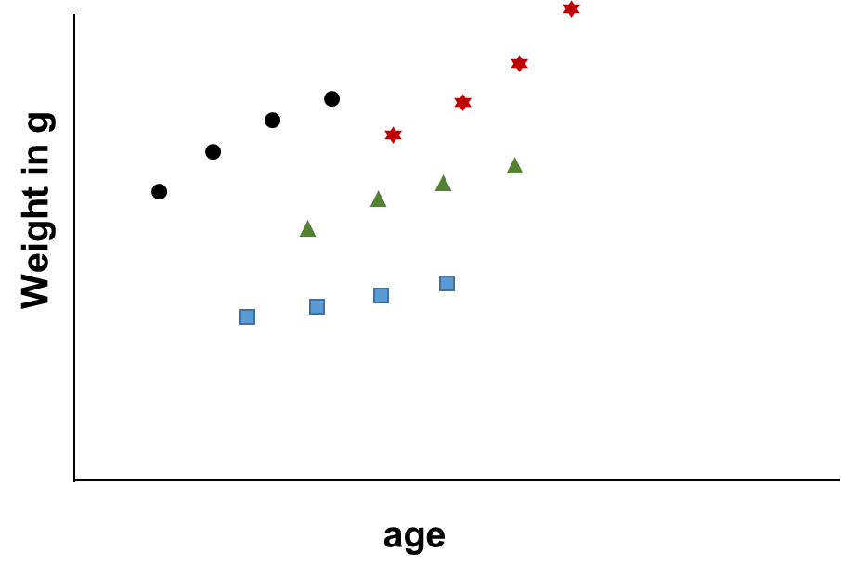



Identity (IDs)
What if…?

Slide 57
Identity (IDs)
What if…?
Repeated measure of same individual

Slide 58
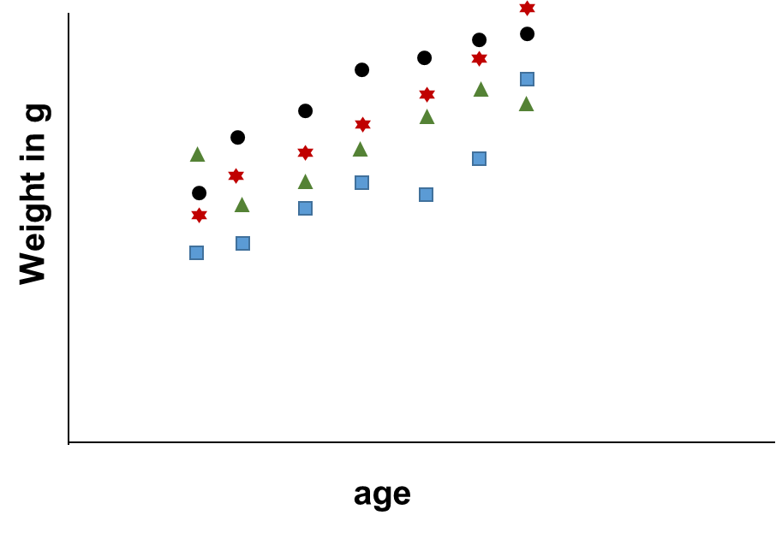
Or…?
Site
Andasibe
Ambohipo
67Ha
Ambohipo

Slide 59
Or…?
Site
Andasibe
Ambohipo
67Ha
Ambohipo
Independent but clustered

Slide 60
Why use LMM, GLMM?
All explanatory variable we have seen in previous models are called variable that have fix effect
Generalized linear mixed models include both fixed effects and random effects in order to allow for :
Repeated measures
Temporal correlation
Nested data
y = β_{i}X_{i}+ b_{i}Zi+ ε
Fixed
Effects
Random
Effects

Slide 61
Random intercept (clustered measures)
y = (α + a _{i}) + β_{i}X_{i}+ ε
Random
Effects
Fixed
Effects
The R function to fit a linear mixed model is lmer() and glmer() for generalized which uses the form
fitted.model <- lmer(formula, data=data.frame)
Formula : weight ̴ age + 1|sites
fitted.model <- glmer(formula, family=“model family”, data=data.frame)
Formula : weight ̴ age + 1|sites

Slide 62


Introduction to Linear Regression
Thank you very much!
Misaotra betsaka!
Hafaliana Christian Ranaivoson
Ecology and Evolution (E&E), University of Chicago
Mention Zoologie et Biodiversité Animale (MZBA), University of Antananarivo
Association Ekipa Fanihy (Efa), Madaggascar.
Adapted from
Andrés Garchitorena, PhD (E2M2, 2024)
E²M² Workshop
Andasibe, May 2025

